Slide 1
Multimodal Emotion Detection in Conversations and Dialogues: A Fusion Model Approach
Presented by - Abhinay Jatoth
Committee:
Dr. Faranak Abri(Advisor)
Dr. Navrati Saxena
Dr. Nada Attar

Slide 2
Agenda
Introduction
Literature review
Dataset
Methodology
Experiment and Results
Conclusion & Future Work

Slide 3
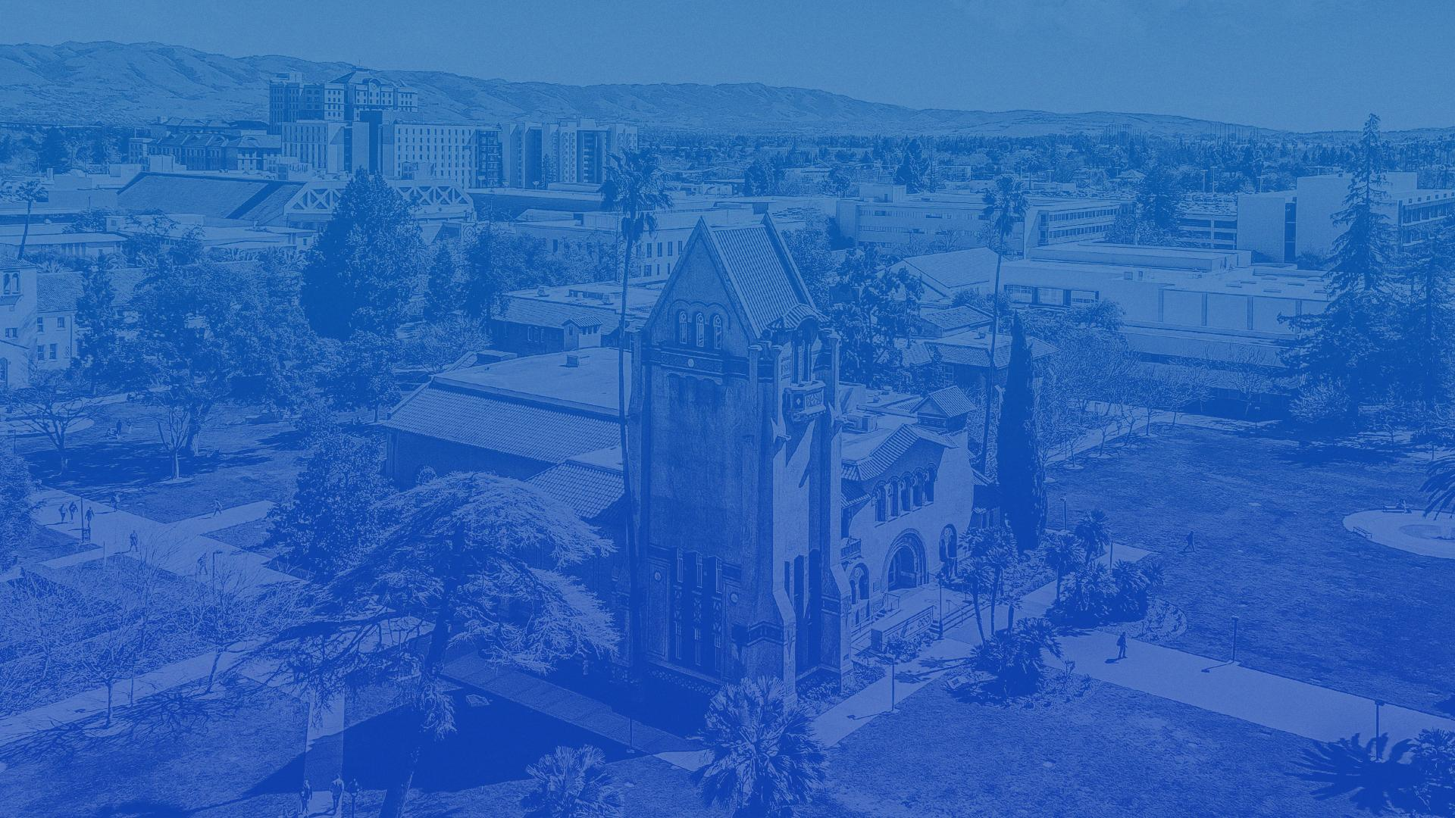
Introduction

Slide 4

Introduction
Emotion : Powerful feeling that defines an individual mental state and guides actions.
Emotion - Feeling which has intensity - Strong feeling
Ex : happiness, love, fear, anger, or hatred
Emotion detection refers to the process of identifying and analyzing emotions expressed in text, speech, or visual modalities individually or combined.
In the context of conversations, it aims to understand the emotional tone.
Sentiment Analysis Emotion Detection Emotion Recognition in Conversations
(positive/negative) (happy,sad, angry) (Emotion in utterances)

Slide 5
Introduction
Why?
Emotions are central to communication and decision-making.
Enhances user experience in customer service, chatbots, virtual assistants, social media analysis, and psychological research
Ex: A chatbot detecting frustration can adjust its responses to calm the user.

Slide 6
Challenges
Ambiguity of Language - e.g: "I'm fine".
Multimodality : Text, Voice, facial expressions and gestures
Subjectivity: Widely across individuals, influenced by situational, social, and cultural factors.
Variation in contextual factors for same dialogue.
Ex : "Yeah!!" can convey different emotions
Presence of Sarcasm & Emotional Shifts.
Data Scarcity: Limited labeled datasets(conversations) for training deep learning models.

Slide 7
Objectives
Data Collection: Collecting conversational dataset with a focus of Text and Audio modalities.
Feature Extraction: Extract meaningful features from the collected data using advanced techniques
Text Embeddings.
Acoustic Features.
Audio Spectrogram Images for visual representation of sound.
Model Training and Classification: Train and evaluate deep learning models to classify emotions in conversations.

Slide 8
Literature Review

Slide 9
Literature Review
A total of 40+ published research papers, journals and articles are reviewed cited for this project and Literature review.
Emotion detection in dialogues and conversation leverages various approaches, primarily categorized into Lexical, Rule-Based, and Machine Learning methods.
Lexical Approach: Focuses on analyzing words and phrases.
Rule-Based Approach: Uses predefined rules and linguistic patterns to classify emotions.
Combined Approach: Utilizes syntactic structures, semantic relationships, and linguistic features to identify context and classify emotion
Machine Learning Approaches: Involves dataset selection, preprocessing, feature extraction, and model training.
Baseline Models
Deep Learning Models
Transformer Models

Slide 10
Lexical and Rule-Based Approaches(Text)
Lexical Approach:
Focuses on analyzing words and phrases.
Utilizes dictionaries like EmoLex or LIWC for emotion classification.
Rule-Based Approach:
Uses predefined rules and linguistic patterns.
Example: Sentences like "I am happy" → tagged as positive emotion.
Combined (Hybrid) Approach:
Combines lexical analysis with syntactic and semantic features.
Better at capturing contextual nuances in text.

Slide 11
Machine Learning Approaches
Machine Learning involves:
Dataset Selection: Public datasets like IEMOCAP, MELD, EmotionLines, MSP-Podcast.
Preprocessing: Removing duplicates, handling missing values, standardizing annotations.
Feature Extraction:
Text Features: Lexical (TF-IDF, n-grams), syntactic (POS tags), semantic (Word2Vec, GloVe).
Audio Features: MFCCs, pitch, energy, spectrograms.
Transformers in NLP:
Models like BERT, RoBERTa, and GPT excel in contextual understanding.
Fine-tuned on emotion datasets for classification.

Slide 12
MultiModal Approaches
Combines text and audio features for more accurate emotion detection.
Text Features: Word embeddings (GloVe, BERT).
Audio Features: MFCC, spectrograms.
Fusion Strategies:
Early Fusion: Combines features before training.
Late Fusion: Combines results from separate models.
Attention Fusion: Add attention layer to each modal while training

Slide 13
Previous Work | Dataset | Methodology | Classes | Modal | Best Metric
P. Chandra et al .[16] | SemEval | GloVe Embeddings + LSTM | 5 | Text | Accuracy - 85%
U. Rashid et al .[17] | SemEval | (Word2Vec,FastText)+BiLSTM | 4 | Text | F1 Score - 69.63%
W. Ragheb et al .[18] | SemEval | Embeddings+BiLSTM | 3 | Text | Micro F1 - 75.8%
M. Farooq et al .[20] | MELD [8] | RoBERTa+BiLSTM | 6 | Text | F1 Score - 60.12%
A. Ando et al .[21] | IEMOCAP | Adaptive CNN & Adaptive LSTM | 4 | Text | W.Accuracy - 61.6%
M. G. Huddar et al .[24] | IEMOCAP | (GloVe,openSmile)+GRU | 5 | T+A+V | F1 Score - 73.3%
B. Arumugam et al .[25] | IEMOCAP | BERT + GRU(Text), VGG + GRU(Audio), Spatial Fusion(BERT+VGG+GRU) | 5 | Text Audio Text+Audio | W.Avg F1 - 62.88% W.Avg F1 - 48.65% W.Avg F1 - 69.65%
C. Zhang et al .[27] | IEMOCAP | CNN+GRU | 4 | Audio | Uw.Avg F1 - 71.2%
H. Xu et al .[37] | IEMOCAP | LSTM+Attn(Text), AttnFusion(Text + Audio) | 4 | Text Text+Audio | W Accuracy - 63.4% W Accuracy - 70.4%

Slide 14
Previous Work | Dataset | Methodology | Classes | Modal | Best Metric
X. Qi et al .[36] | IEMOCAP | MFGCN | 4 | Text+Audio | W.Accuracy - 78.3%
D. Mamieva et al .[38] | IEMOCAP | Attn +CNN | 4 | Text+Audio | F1 Score - 66.1%
S. Siriwardhana et al .[39] | IEMOCAP | Transformer Fusion | 4 | T+A+V | F1 Score - 84.1%
S. Siriwardhana et al .[39] | MELD | Transformer Fusion | 7 | T+A+V | F1 Score - 63.9%
P. Liu et al .[40] | IEMOCAP | Gated Fusion | 4 | Text+Audio | W Accuracy - 72.39%

Slide 15
Dataset

Slide 16
Dataset
IEMOCAP (Interactive Emotional Dyadic Motion Capture dataset):
IEMOCAP, developed by USC is the primary dataset for this experimentation.
Emotion recognition labelled by 6 Annotators.
12 hours of recorded data from 10 actors (5 male, 5 female) with 150 conversations and 9953 samples.
Modalities - Text, Audio, Video, Head Movement & Angle Information, Motion Capture Face Information
Categorical Attributes: anger, happiness, excitement, sadness, frustration, fear, surprise, other and neutral state
Dimensional Attributes: valence, activation, dominance
Challenges: Size, noise, annotation issues
EMOV (Emotional Voices dataset for speech emotion recognition):
EMOV dataset is a collection of emotional speech recordings by 4 speakers(2 male and 2 female)
6,893 audio clips.
Categorical Attributes: neutral, sleepiness, anger, disgust, and amused

Slide 17
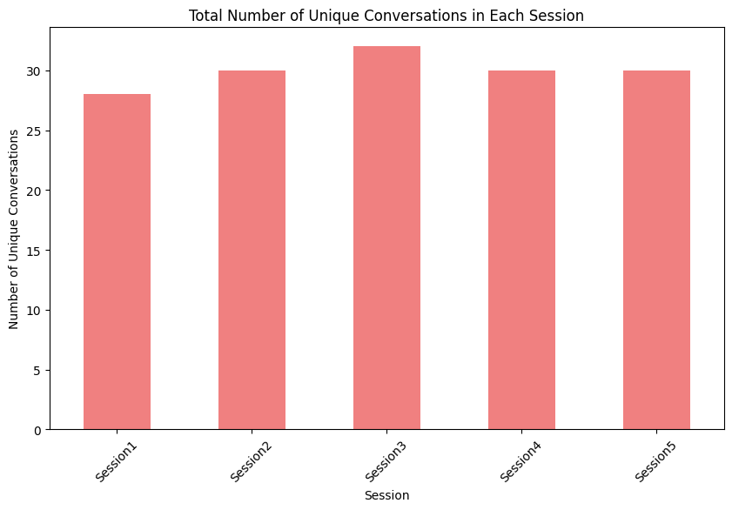
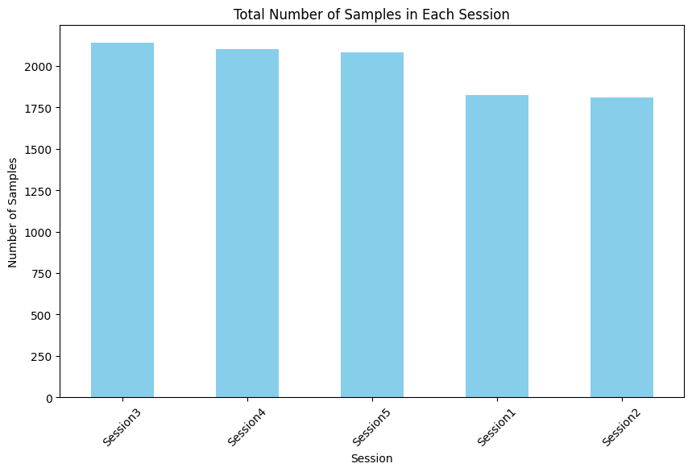
Dataset
IEMOCAP : Contains 5 sessions of recordings
Plot showing the number of conversations in each session
Plot showing the number of utterance(samples) in each session

Slide 18
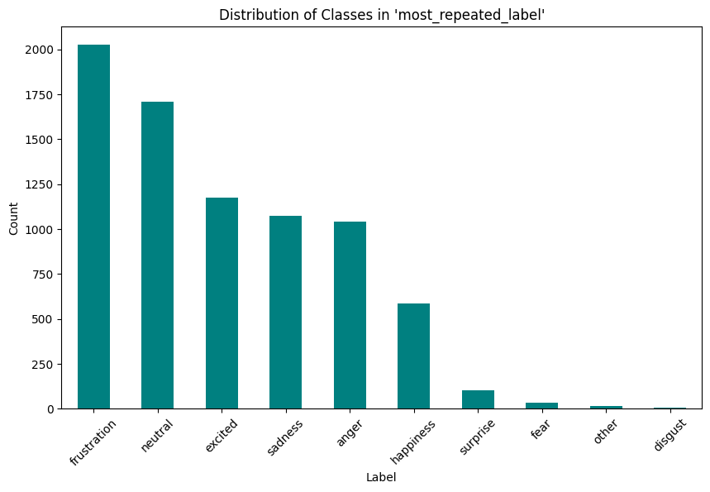
Dataset
IEMOCAP
Plot showing the distribution of categorical labels in IEMOCAP dataset after considering the label which is annotated more than one time.

Slide 19
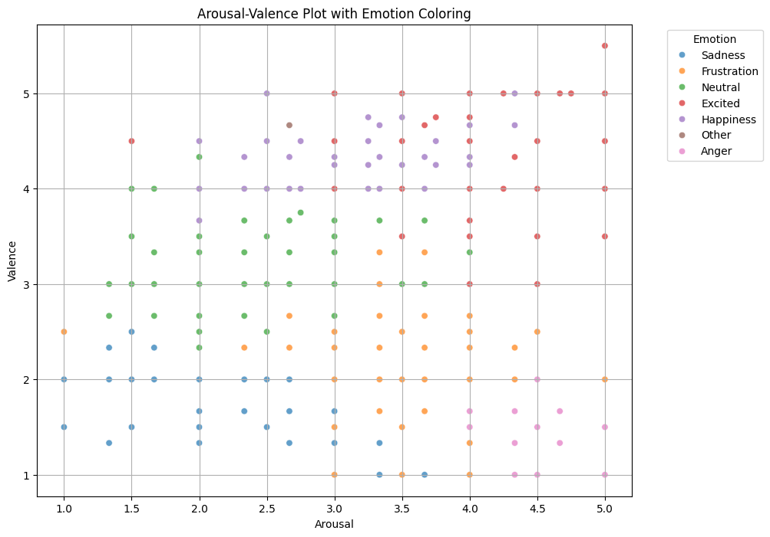
Dataset
IEMOCAP
Plot showing the dimensional distribution of arousal and valence in IEMOCAP dataset.

Slide 20
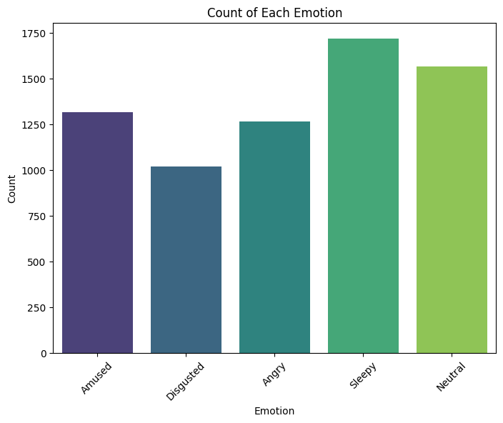
Dataset
EMOV
Plot showing the distribution of categorical labels in EMOV dataset(6,893 audio clips).

Slide 21
Dataset
Dataset preliminary Considerations:
Label agreed by majority annotators is considered as final label
Classes:
Filtered to six emotion labels - happy, sad, neutral, angry, excited, and frustrated.
Simplified to Four emotion labels - happy(excited + happy), anger(frustrated+angry), sad, neutral.
Result Samples: 7613
Sample with token size >= 10 : 4489
Focus on textual and audio modalities to predict categorical emotion labels.

Slide 22
Methodology

Slide 23
Methodology
Word Representations Before Transformers:
Words were represented as static vectors (e.g., Word2Vec, GloVe).
These embeddings missed context because each word had a single fixed representation.
Example: "bank" in "river bank" vs. "financial bank" has the same vector representation.
Context Is Critical in Emotion Detection:
The meaning and emotional tone of words depend on their context in conversations.
Example: "I’m fine" can indicate calmness, sarcasm, or frustration, depending on context.

Slide 24
Methodology
What Is a Transformer?
An Encoder-Decoder architecture that uses the Attention Mechanism.
Key Features of Transformers:
Attention Mechanism:
Assigns different levels of importance to words (features).
Captures relationships between words regardless of their distance in the sentence.
Parallelization:
Processes all tokens at once.
Takes advantage of GPUs/TPUs for faster computation.
Improved Context Understanding:

Slide 25
Text-Based Models
Model Architecture
Pretrained transformer models (e.g., BERT, RoBERTa) used for feature extraction.
Classification layers:
Fully connected layer for direct classification.
Bi-directional LSTM for sequential context processing.
BERT :
Captures bidirectional context.
Pretrained on two tasks:
Masked Language Modeling (MLM).
Next Sentence Prediction (NSP).
RoBERTa:
Robustly optimized BERT.
Focuses only on MLM for better token representations.

Slide 26
Text-Based Models
Embedding Generation by BERT/RoBERTa:
Input text is tokenized using the tokenizer specific to the model (e.g., BERT tokenizer for BERT, RoBERTa tokenizer for RoBERTa).
The tokenization process converts sentences into subword tokens and adds special tokens:[CLS][SEP]
The tokenized input is passed into the BERT/RoBERTa encoder to generate contextual embeddings for each token.
Token Embedding
Positional Embedding
Self-Attention Mechanism

Slide 27
Audio-Based Models
Overview:
Extract and analyze acoustic features from audio data for emotion classification.
Feature Extraction:
Used Librosa library to extract relevant audio features and preprocess data.
Acoustic features include - Mel-Frequency Cepstral Coefficients (MFCCs), Pitch, Energy, Spectral Centroid, Rolloff, Bandwidth, Chroma, Zero-Crossing Rate and Loudness
Audio files converted to mono channel and sampled at 16 kHz.
Models Used:
Bi-Directional LSTM (BiLSTM).
Audio Spectrogram Transformer (AST).
Wav2Vec2.

Slide 28
Audio-Based Models
BiLSTM for Emotion Detection:
BiLSTM Layers:
Two BiLSTM Layers with 128 and 64 units, respectively.
Captures sequential dependencies in the audio data.
Dropout Layers:
Dropout rate of 0.2 after each BiLSTM layer to prevent overfitting.
Training Configuration:
Optimizer: Adam (learning rate: 0.001).
Loss Function: Categorical Cross-Entropy.
Evaluation Metric: Accuracy.

Slide 29
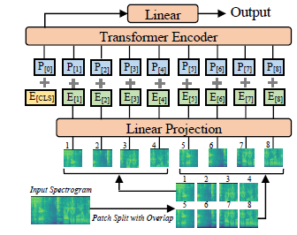
Audio-Based Models
Audio Spectrogram Transformer (AST) (Y. Gong et al [39])
A Transformer-based model that processes audio spectrograms for emotion detection.
Converts raw audio into spectrograms (visual representation of frequency over time).
Steps in AST Pipeline:
Spectrogram Generation: Convert raw audio waveform into a spectrogram.
Patch Embeddings: Divide the spectrogram into smaller patches.
Transformer Encoder:
Processes embedded patches using self-attention to capture long-range dependencies in the audio.
Classification Head: Predicts emotion labels from the Transformer encoder output.

Slide 30
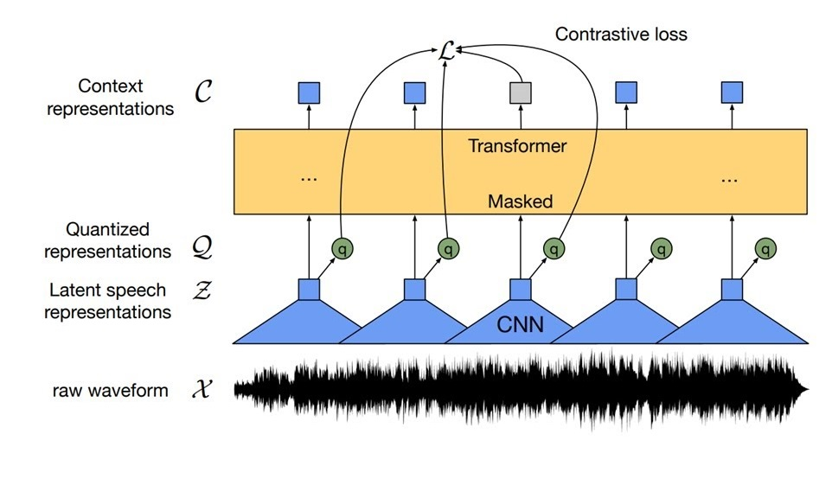
Audio-Based Models
Wav2Vec2 for Emotion Detection(A. Baevski et al [40])
A self-supervised learning model for audio analysis.
Learns speech representations from raw waveforms and fine-tunes on labeled tasks like emotion classification.
Steps in Wav2Vec2 Pipeline:
Feature Encoder: Uses convolutional layers to extract low-level features from raw audio.
Context Network:Processes features using a Transformer to capture context and dependencies within audio signals.
Fine-Tuning: Adapts pre-trained Wav2Vec2 to emotion classification using labeled emotion datasets.

Slide 31
Fusion-Based Models
Fusion-Based Emotion Detection:
Combines textual and audio features for multimodal analysis.
Features extracted:
Text: Pretrained RoBERTa embeddings.
Audio: Acoustic features extracted using Librosa.
Fusion Methods Explored:
Late Fusion.
Hierarchical Attention Fusion.
Cross-Modal Transformer Fusion.
Gated Multimodal Fusion.

Slide 32
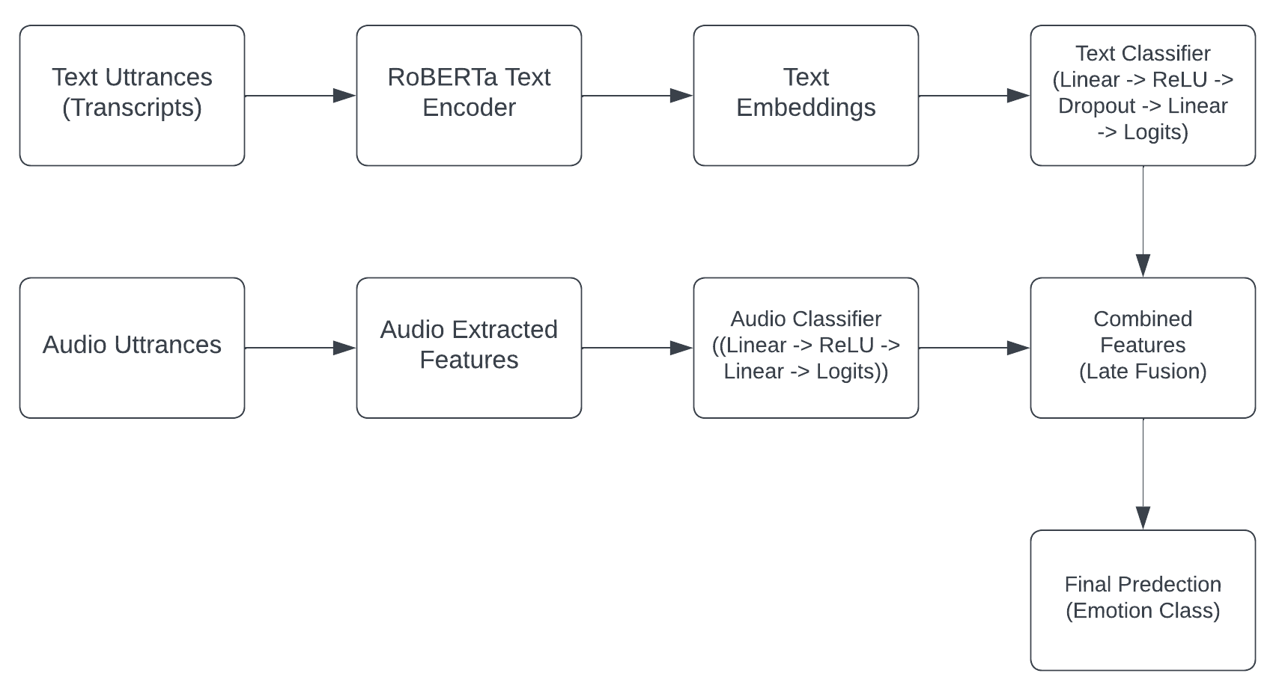
Fusion-Based Models
Late Fusion:
Steps:
Text and audio are processed independently.
Separate classifiers for text and audio.
Outputs combined at the logit level using averaging.
Final logits used for emotion classification.
Advantages:
Simple and efficient.
Allows independent specialization of modalities.
Limitation:
Limited interaction between modalities.
Architecture of proposed Late Fusion Model

Slide 33
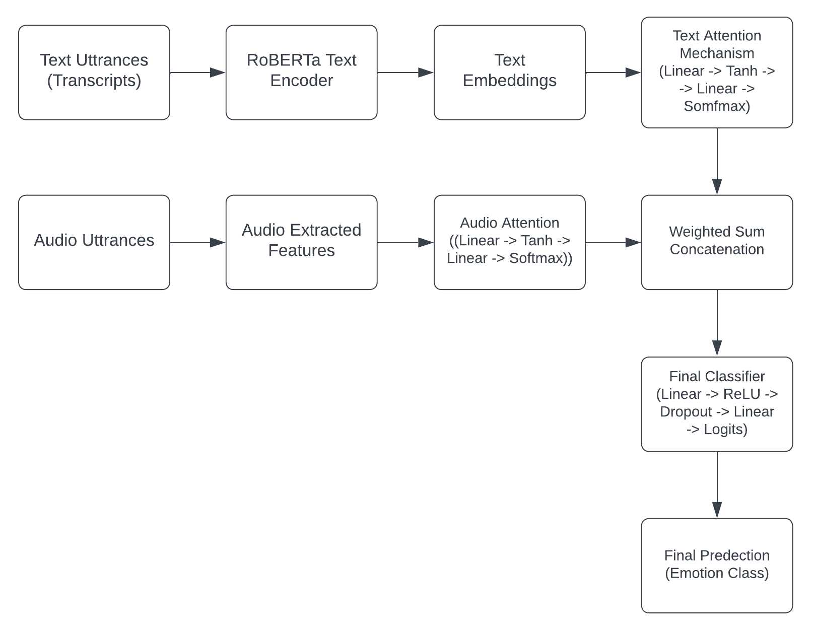
Fusion-Based Models
Hierarchical Attention Fusion:
Steps:
Text Processing:
RoBERTa embeddings.
Attention mechanism assigns weights to focus on important phrases.
Audio Processing:
Attention layer focuses on key audio signals.
Fusion:
Concatenates text and audio features.
Passed through a feed-forward classifier with ReLU and dropout.
Advantages:
Prioritizes modality-specific critical features.
Architecture of proposed Hierarchical Attention Fusion Model

Slide 34
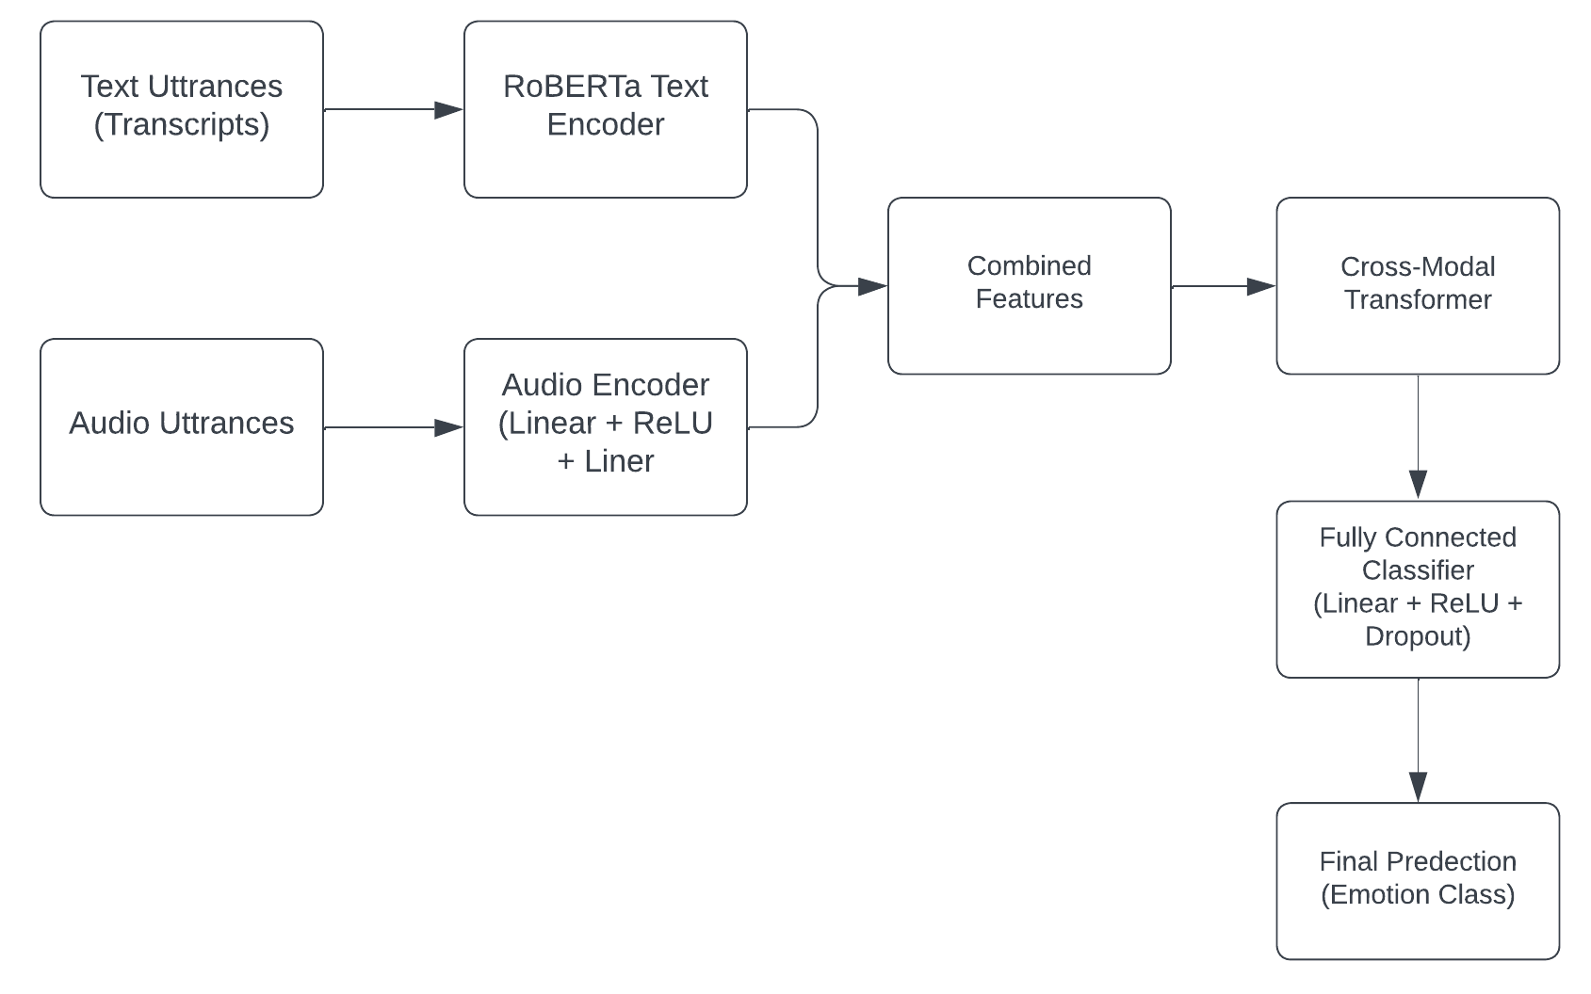
Fusion-Based Models
Cross-Modal Transformer Fusion:
Steps:
Text Processing: RoBERTa embeddings extracted.
Audio Processing: Audio features processed through an encoder.
Fusion:
Text and audio embeddings concatenated.
Passed through a transformer encoder (8 attention heads, 2 layers).
Models long-range dependencies and cross-modal interactions.
Advantages:
Captures complex relationships between text and audio.
Architecture of proposed Cross-Modal Transformer Fusion

Slide 35
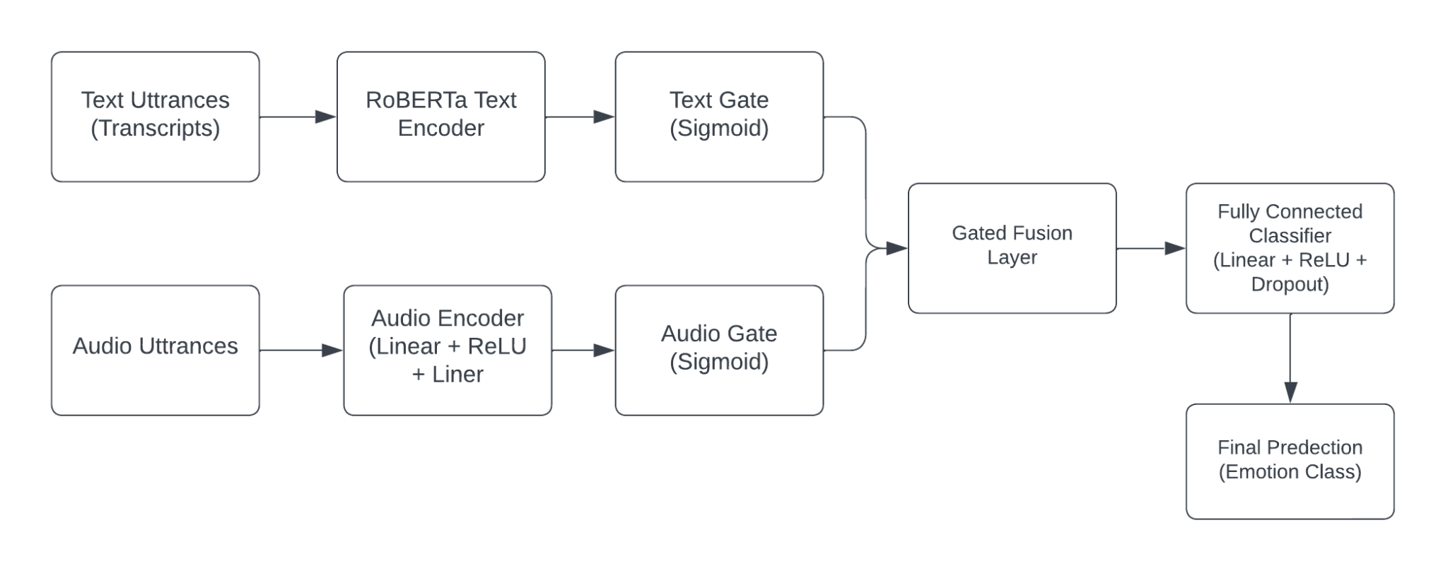
Fusion-Based Models
Gated Multimodal Fusion:
Steps:
Text Processing: RoBERTa embeddings extracted.
Audio Processing: Audio features processed through an encoder.
Gating Mechanism:
Gating networks dynamically assign weights to text and audio features.
Ensures robust integration, even when one modality is noisy.
Fusion and Classification:
Fused features passed through a fully connected network with dropout.
Advantages:
Handles noisy or unreliable modalities effectively.
Architecture of proposed Gated Multimodal Fusion Model

Slide 36
Experimentation

Slide 37
Experimentation
Text Based Models:
Text based models was fine-tuned on IEMOCAP dataset for emotion detection tasks.
Models Used:
BERT (bert-base-uncased): Captures bidirectional context in text.
RoBERTa (roberta-base): Robustly optimized version of BERT, capturing richer contextual information.
BiLSTM: Processes sequential data and captures long-term dependencies in both directions.
Training Configurations:
BERT & RoBERTa:
Batch Size: 5, Learning Rate: 2 × 10⁻⁵, Dropout: 0.3, Optimizer: Adam, Loss: CrossEntropyLoss.
BiLSTM (Bidirectional LSTM):
Batch Size: 16, Learning Rate: 2 × 10⁻⁵, Dropout: 0.2, Optimizer: Adam, Loss: CrossEntropyLoss

Slide 38
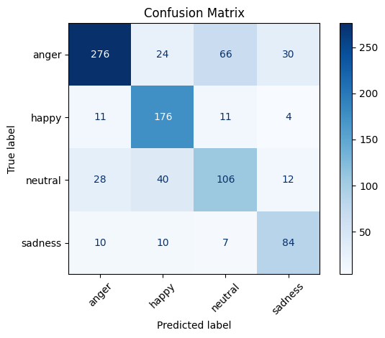
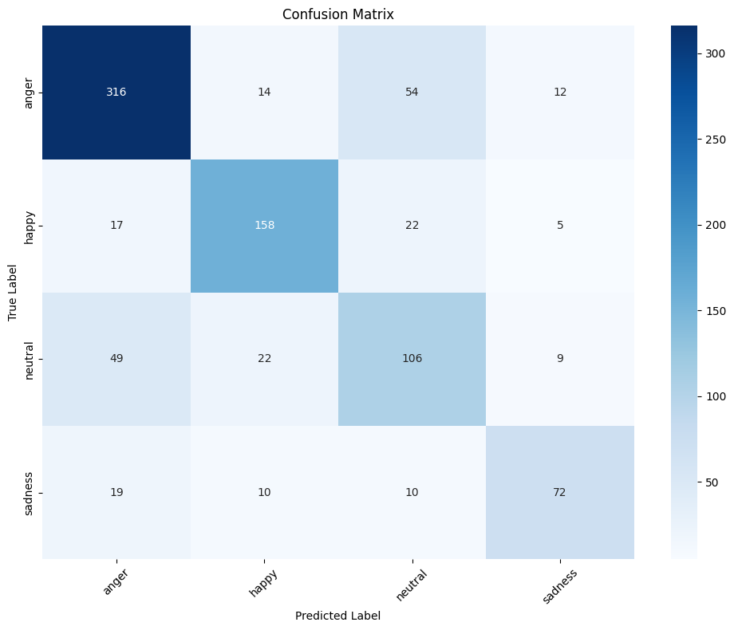
Experimentation
Performance Results (Weighted F1 Score):
BERT : 69.92%
RoBERTa : 72.37%
BERT + BiLSTM : 72.75%
RoBERTa + BiLSTM : 73.33%
Confusion Matrix for BERT + BiLSTM
Confusion Matrix for RoBERTa + BiLSTM

Slide 39
Experimentation
Audio Based Models:
Audio based models was fine-tuned on IEMOCAP and EMOV dataset for emotion detection tasks. The models leverage acoustic features or raw audio encoders to predict emotion classes.
BiLSTM (with Acoustic Features):
Two Bi-directional LSTM layers: 128 units (first layer) and 64 units (second layer).
Dropout: 0.2 after each layer.
Dense layer with softmax activation for emotion classification
Training Configuration:
Optimizer: Adam (Learning Rate = 0.001).
Loss Function: Categorical Cross-Entropy.
Batch Size: 32.
Epochs: 15.
Performance:
IEMOCAP F1 Score : 62.08%.
EMOV F1 Score : 97%

Slide 40
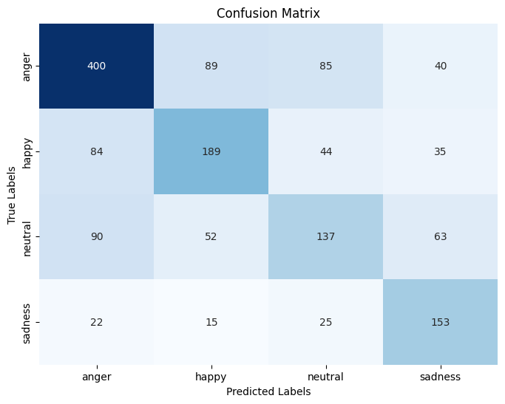
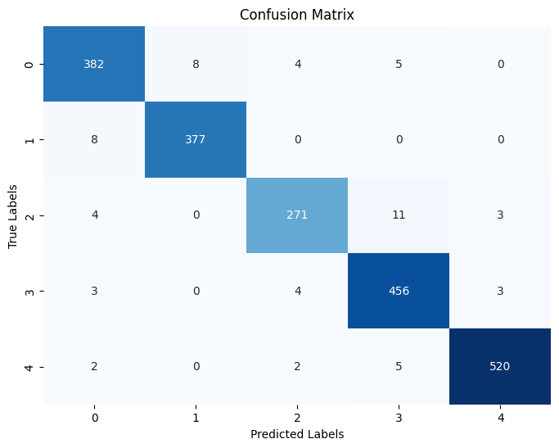
BiLSTM (with Acoustic Features):
Confusion Matrix for BiLSTM trained on Acoustic Features on IEMOCAP
Confusion Matrix for BiLSTM trained on Acoustic Features on EMOV

Slide 41
Experimentation
Audio Spectrogram Transformer (AST):
Approximately 5.3 million trainable parameters.
Uses a spectrogram-based feature extractor.
Training Configuration:
Batch Size: 16.
Epochs: 10.
Learning Rate: 5 × 10⁻⁶.
Weight Decay: 0.2.
Gradient Accumulation: 1 step.
Checkpointing: Enabled for gradient optimization and best model selection.
Performance:
IEMOCAP F1 Score : 64.99% (better than BiLSTM)..
EMOV F1 Score : 98.96%.

Slide 42
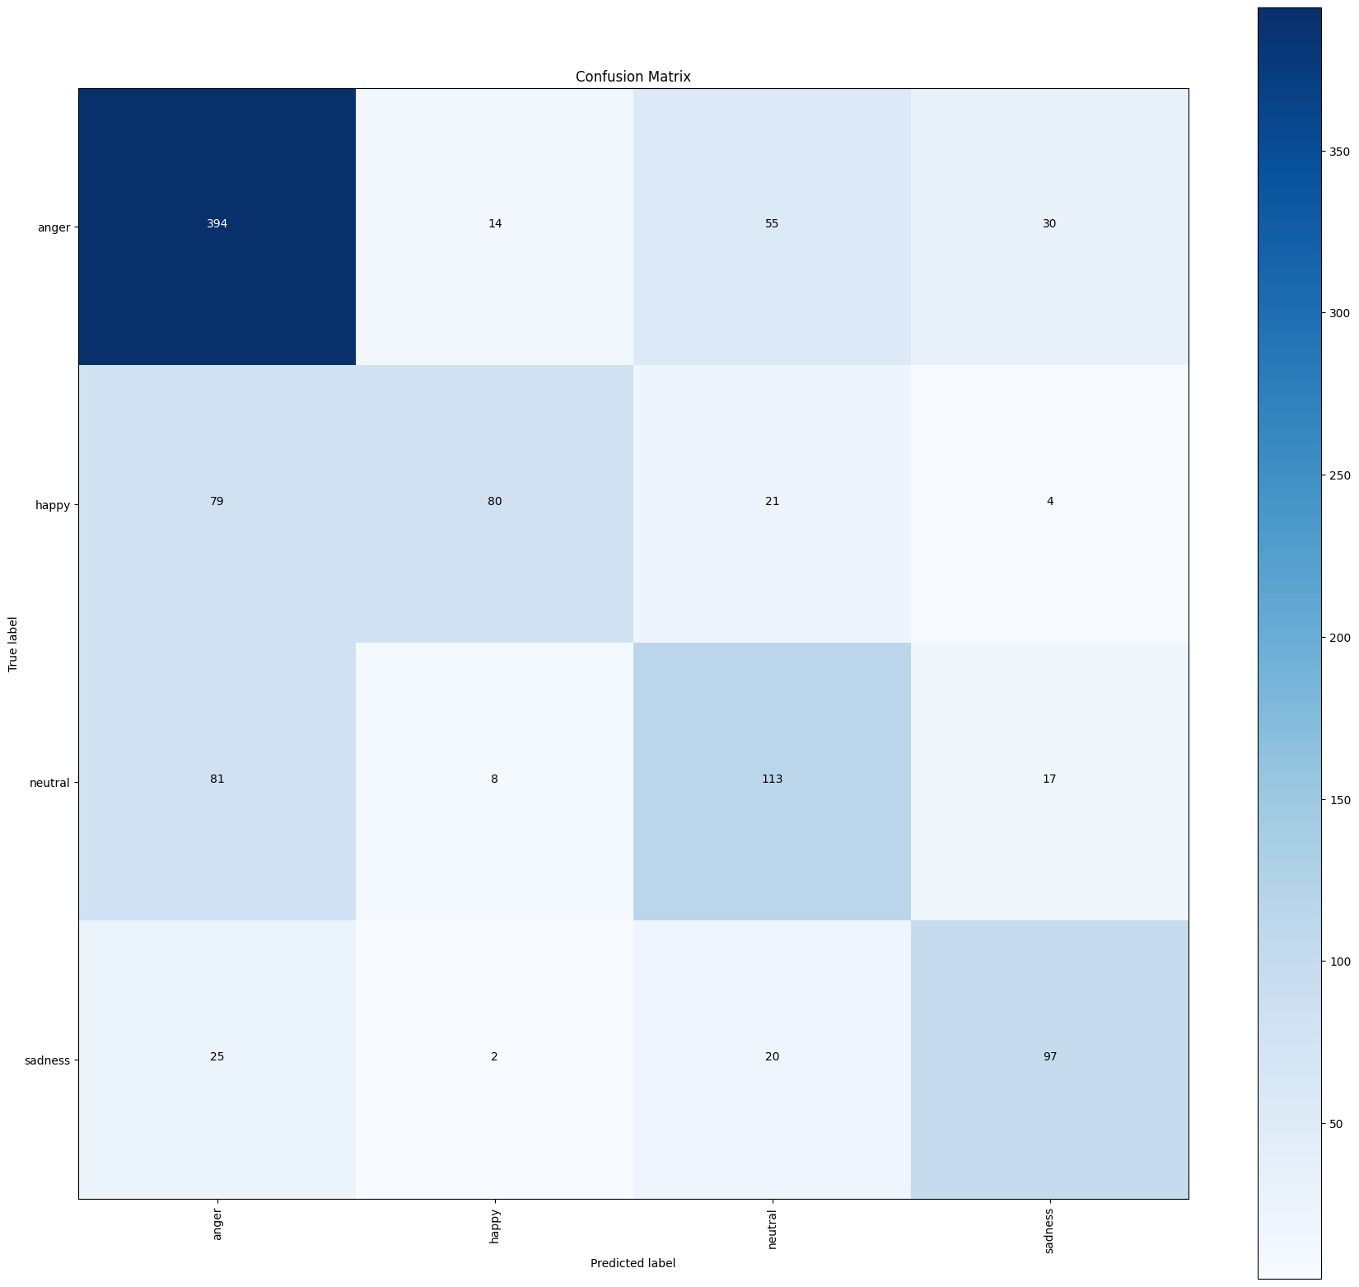
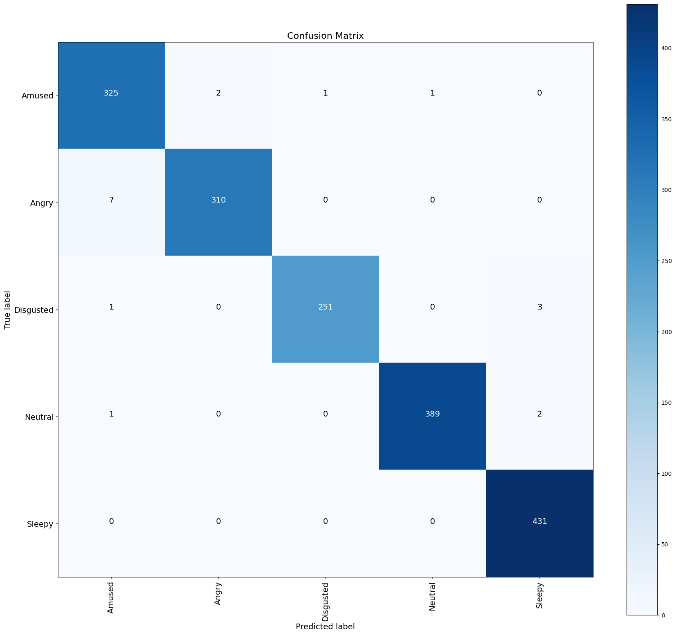
Audio Spectrogram Transformer (AST):
Confusion Matrix of AST trained on IEMOCAP
Confusion Matrix of AST trained on EMOV

Slide 43
Experimentation
Audio Spectrogram Transformer (AST):
Approximately 95 million trainable parameters.
Uses a convolutional feature encoder and Transformer-based context network to process raw audio.
Training Configuration:
Batch Size: 16.
Epochs: 30.
Learning Rate: 1 × 10⁻⁵.
Weight Decay: 0.02.
Warmup Steps: 50.
Gradient Accumulation: 1 step.
Early Stopping: Enabled with a patience of 3 epochs.
Checkpointing: Enabled for gradient optimization and best model selection.
Performance:
IEMOCAP F1 Score : 66.9981 (Best among Audio for IEMOCAP).
EMOV F1 Score : 99.48%.(Overall Best)

Slide 44
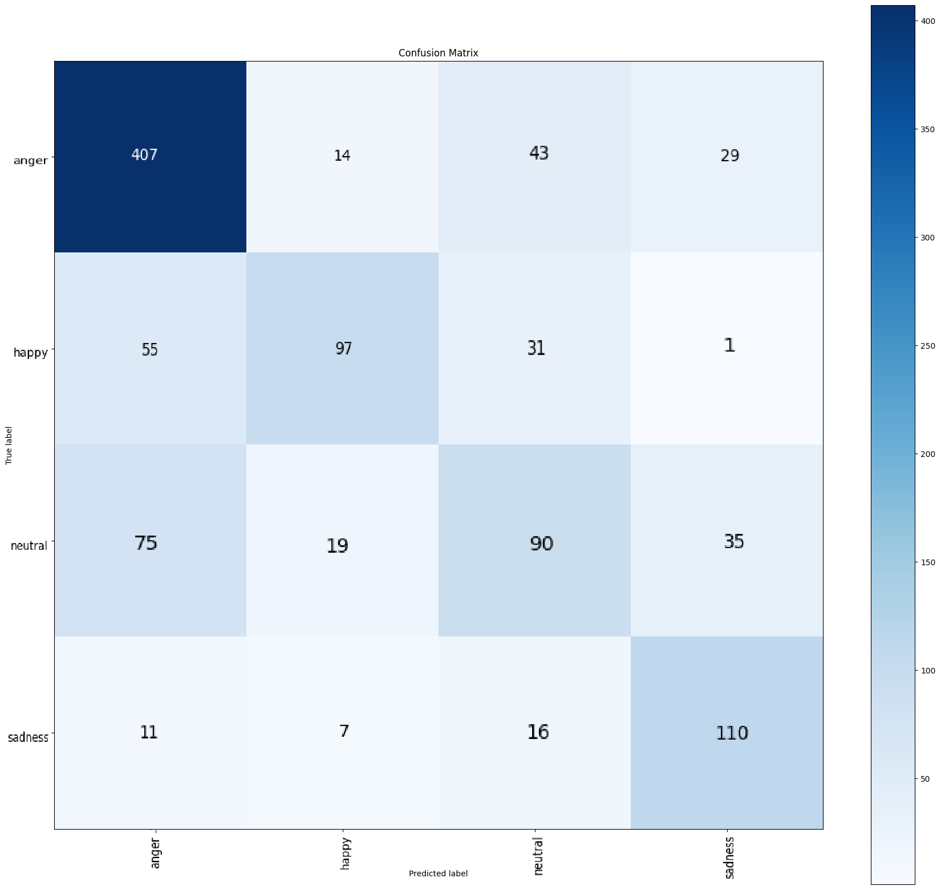
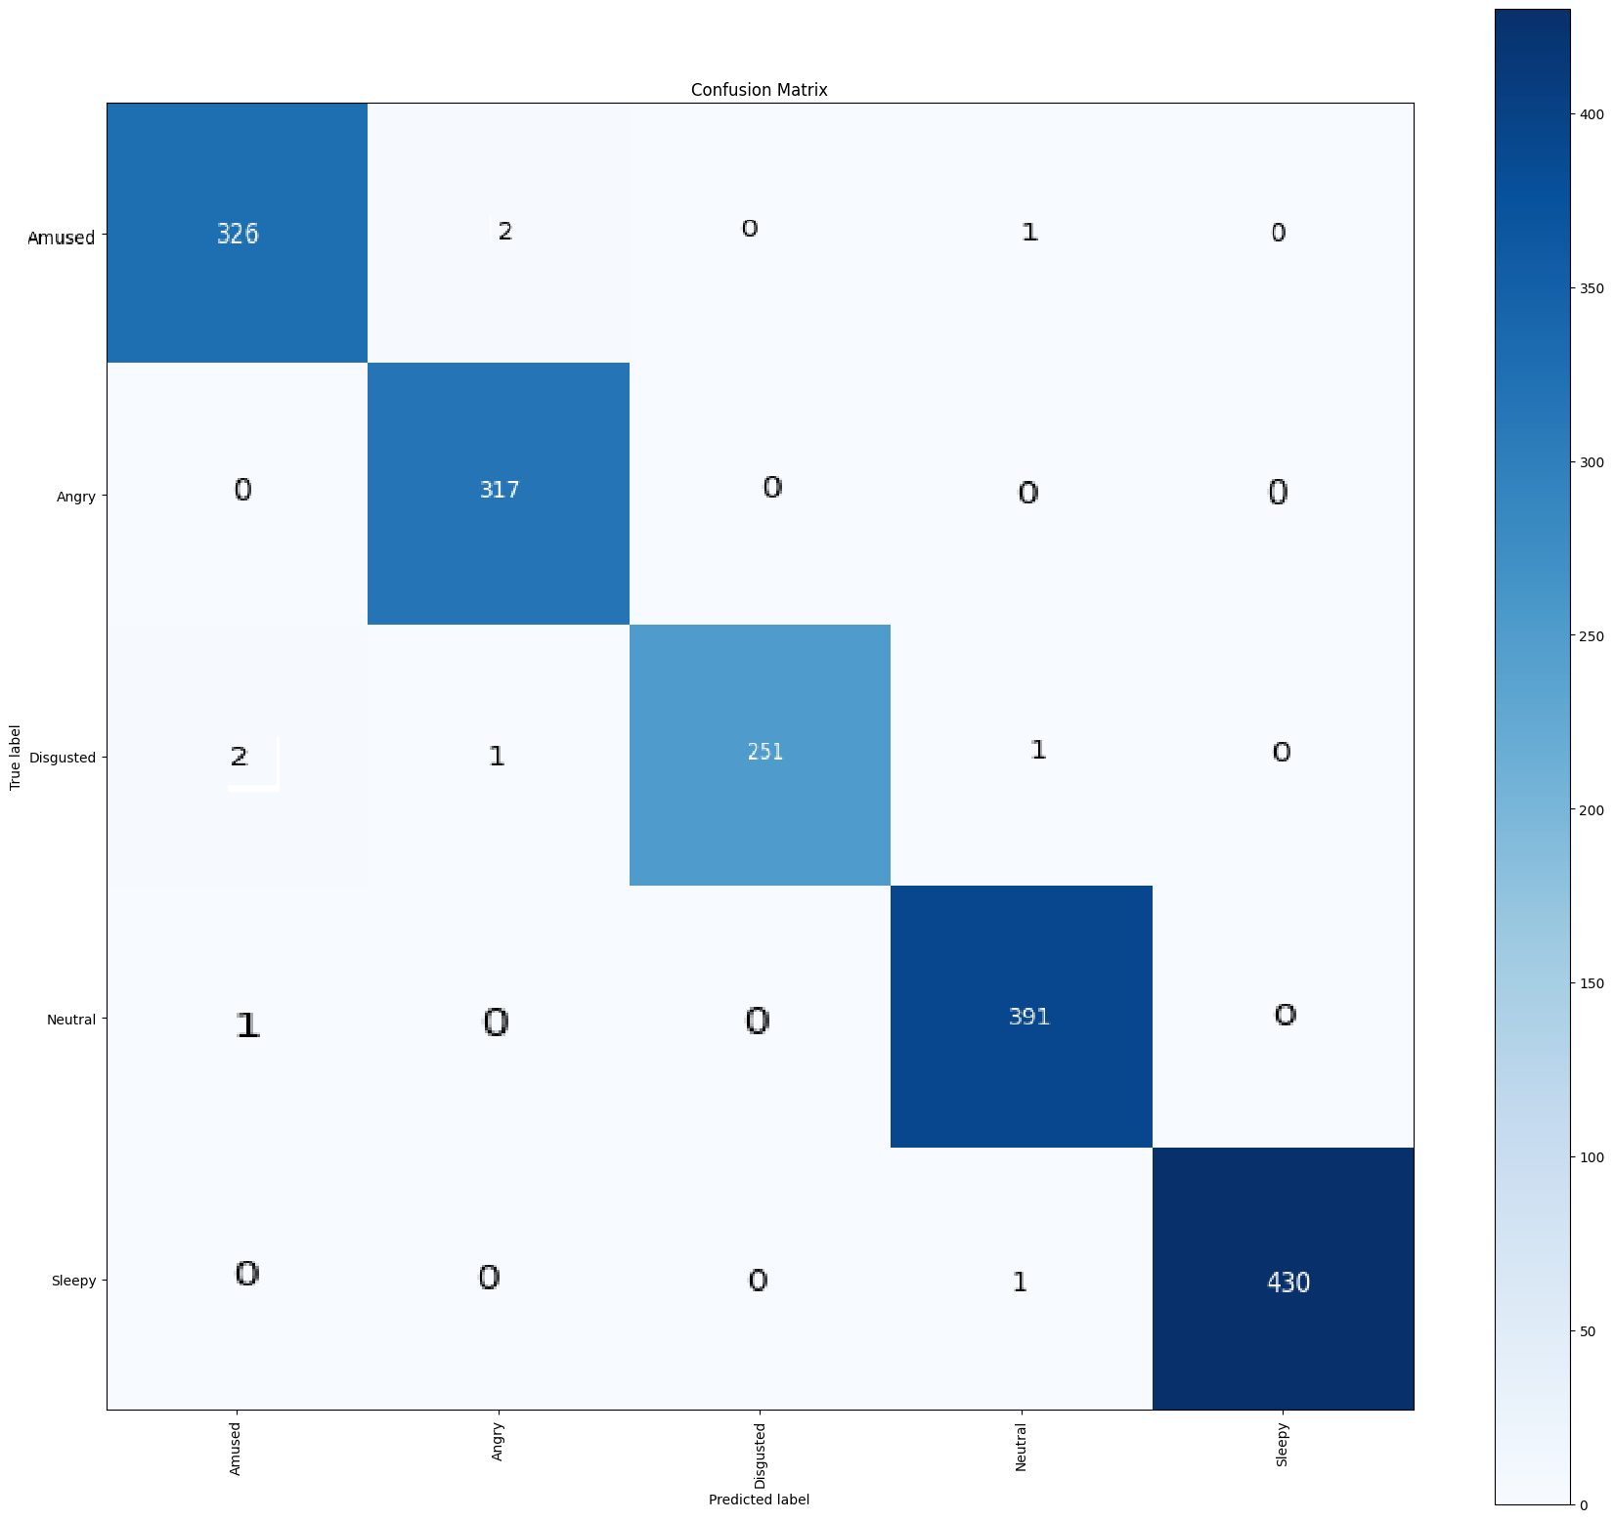
Wav2Vec2 :
Confusion Matrix of Wav2Vec2 trained on IEMOCAP
Confusion Matrix of Wav2Vec2 trained on EMOV

Slide 45
Experimentation
Performance of Fusion Based on IEMOCAP:
Model | Weighted F1 Score
Late Fusion | 76.62%
Hierarchical Attention | 75.57%
Cross-Modal Transformer | 75.37%
Gated Multimodal Fusion | 76.04%

Slide 46
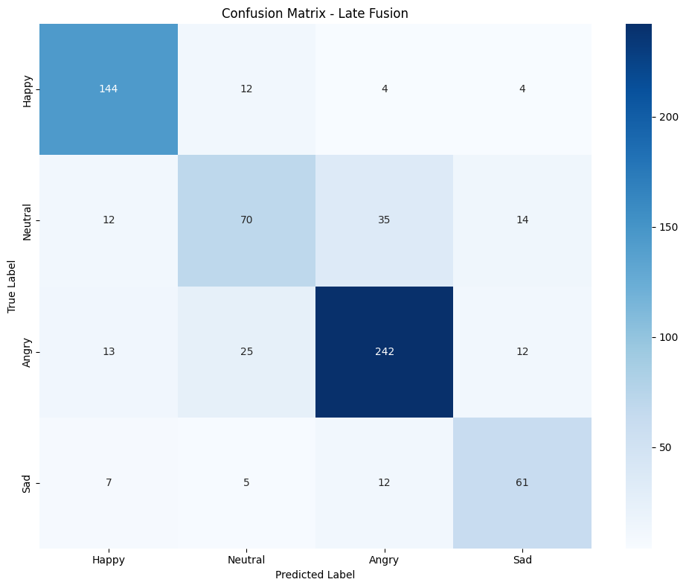
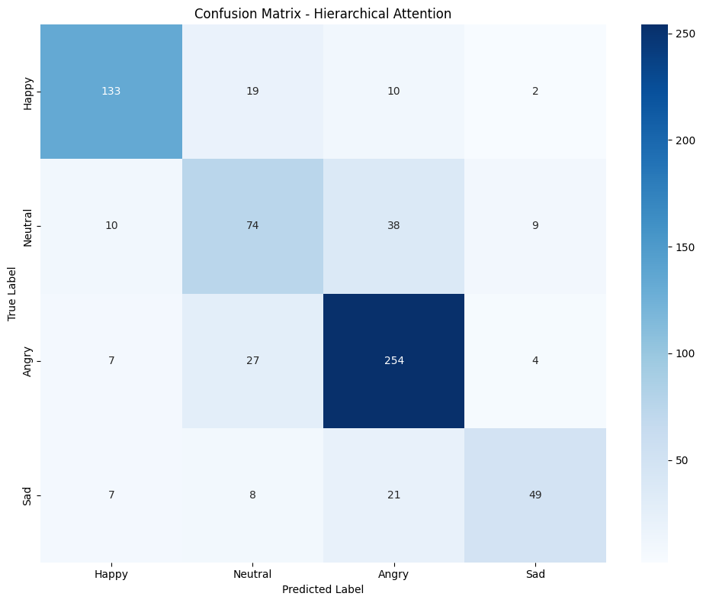
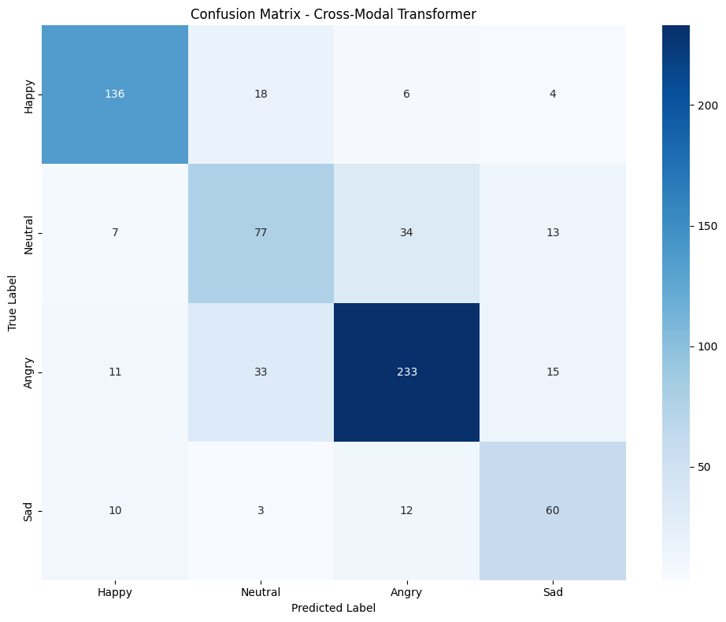
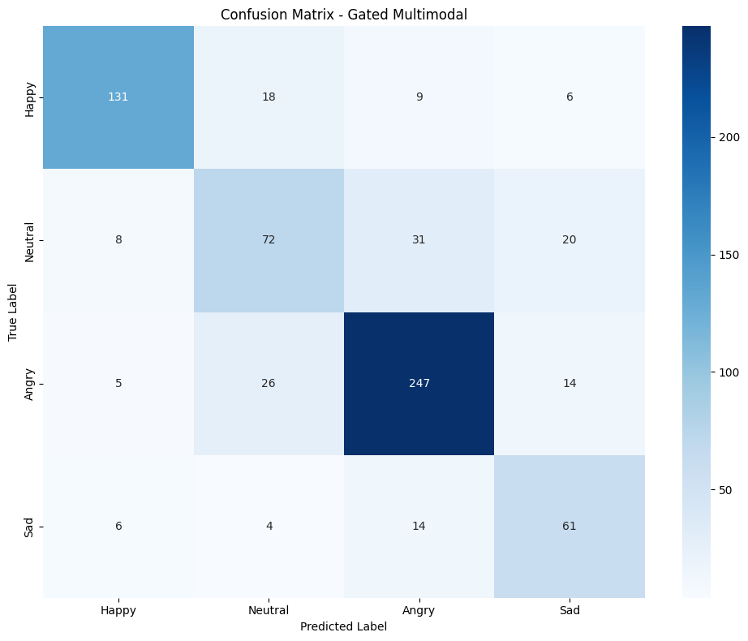
Confusion Matrix of Fusion Models:
Late Fusion
Hierarchical Attention
Cross-Modal Transformer
Gated Multimodal Fusion

Slide 47
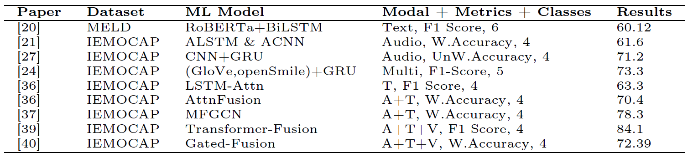
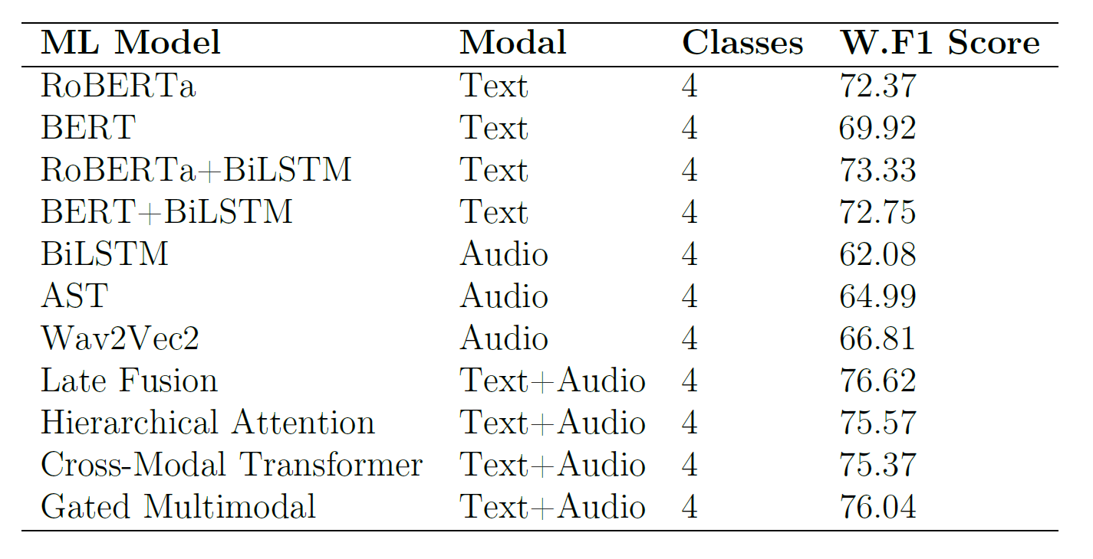
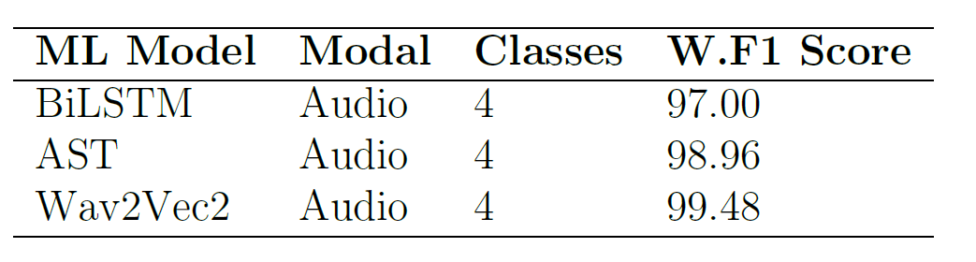
Results Summary and Comparison
RoBERTa+BiLSTM showed similar results when number of predicted classes are taken into consideration
AST and Wav2Vec2, not evaluated in prior literature, achieved 64.99 and 66.81, better compared to other Audio models.
Fusion models improved performance by 2-6 percentage points, demonstrating the advantage of combining text and audio information effectively.
Gated Fusion also improved slightly from 72.39 to 76.04, and Attention Fusion improved from 70.4 to 75.57
IEMOCAP
EMOV

Slide 48
Conclusion & Future Work

Slide 49
Conclusion & Future Work
Key Observations:
Text-based models (e.g., RoBERTa+BiLSTM) perform well on conversational datasets.
Audio-based models excel on datasets like EMOV (e.g., Wav2Vec2 with 99.48% F1) which shows the complexity of IEMOCAP dataset as different speakers tones are involved for same emotion unlike IEMO.
Fusion models outperform individual modalities on complex datasets like IEMOCAP.
Future Directions:
Incorporating visual modalities (e.g., facial expressions) for improved performance.
Expanding experiments to include more emotion classes with dimensional labels and larger datasets.
Exploring advanced architectures like multi-modal transformers.
Applying models to real-world applications (e.g., AI chatbots, healthcare systems).

Slide 50
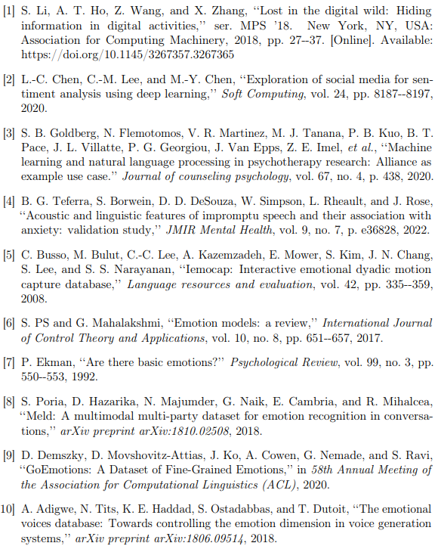
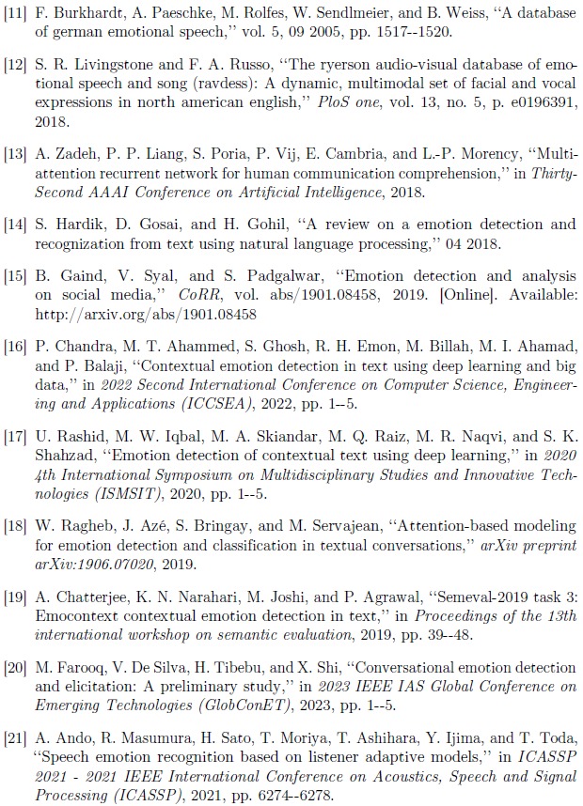
References

Slide 51
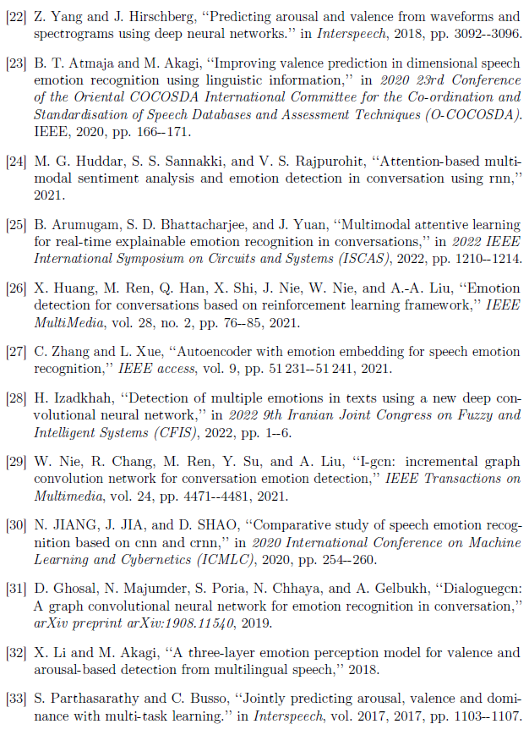
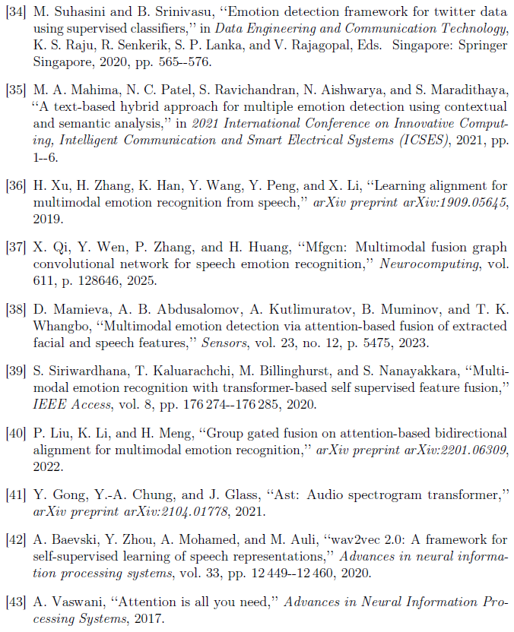
References

Slide 52
Thank you!

